Slide 1
Intelligent Access Control System For Safety Critical Areas In Industries
V H J
VINAY
MANIKANTA
NARENDRA

Slide 2
Contents
Abstract of Project with Problem Statement
Components
Block diagram for Face Recognition System
Block Diagram for Text To Speech Conversion
Project working process
Coding Part

Slide 3
Abstract of Project with Problem Statement
In some industries it is necessary for the workers to wear safety helmets and shoes while working. So to check weather workers are taking safety precautions or not we are proposing this system.
We can train our classifier to identify helmet and safety shoes with IBM Cloud. There will be video streaming near the entry of the industries where we can first detect the face of a person and if any person is present then we can capture the image of that moment and send it to IBM Cloud to detect whether the person is wearing helmet or shoe.
If the person is wearing shoe and helmet we can give him access by opening the door. If he is not wearing then we can restrict his access by not opening the door. We can even warn him through voice commands to take the safety precautions.

Slide 4
Components
Hardware Components
1.Raspberry pi3 Model B
2.USB Camera
3.SD card
4.Speakers
Software Components
1.Noobs
2.Python IDLE
3.Clarifai Visual Recognition Engine

Slide 5
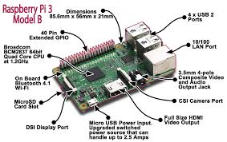
Hardware Components
1.Raspberry Pi
SOC: Broadcom BCM2837 CPU: 4× ARM Cortex-A53, 1.2GHz GPU: Broadcom VideoCore IV RAM: 1GB LPDDR2 (900 MHz) Networking: 10/100 Ethernet,
2.4GHz 802.11n wireless Bluetooth: Bluetooth 4.1 Classic,
Bluetooth Low Energy Storage: microSD GPIO: 40-pin header, populated Ports: HDMI, 3.5mm analogue audio-video jack, 4× USB 2.0, Ethernet, Camera Serial Interface (CSI), Display Serial Interface (DSI)

Slide 6
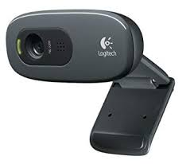
Hardware Components
2.USB Camera
HD 720p video calling and HD video recording, 2.4 GHz Intel Core2 Duo, 2 GB RAM,200 MB hard drive space
Video capture: Up to 1280 x 720 pixels, Logitech Fluid Crystal
Crisp 3 MP photos Technology, Hi-Speed USB 2.0

Slide 7
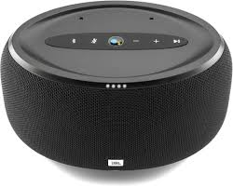
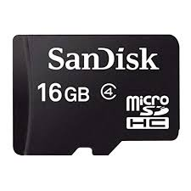
Hardware Components
3.SD card 4.Speakers
capacity: 16GB

Slide 8
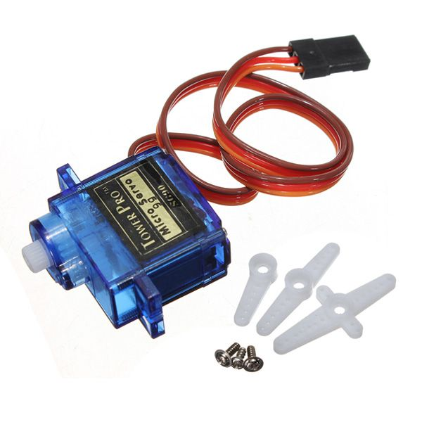
Hardware Components
5.Servo Motor
A servo motor is a closed-loop system that uses position feedback to control its motion and final position. In industrial type servo motors the position feedback sensor is usually a high precision encoder, while in the smaller RC or hobby servos the position sensor is usually a simple potentiometer.

Slide 9
Software Components
1.Python IDLE
IDLE is integrated development environment (IDE) for editing and running Python 2.7.3
The IDLE GUI is automatically installed with the Python interpreter. IDLE was designed specifically for use with Python
IDLE has a number of features to help you develop your Python programs including powerful syntax highlighting.

Slide 10
Software Components
2.Clarifai
Clarifai Inc. is an artificial intelligence (AI) company that specializes in computer vision and uses machine learning and deep neural networks to identify and analyze images and videos. The company offers its solution via API, mobile SDK, and on-premise solutions.Clarifai is headquartered in New York City with two satellite offices in San Francisco and Washington D.C.Clarifai API

Slide 11
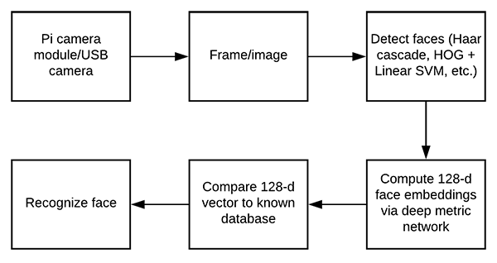
Block Diagram for Face Recognition System

Slide 12
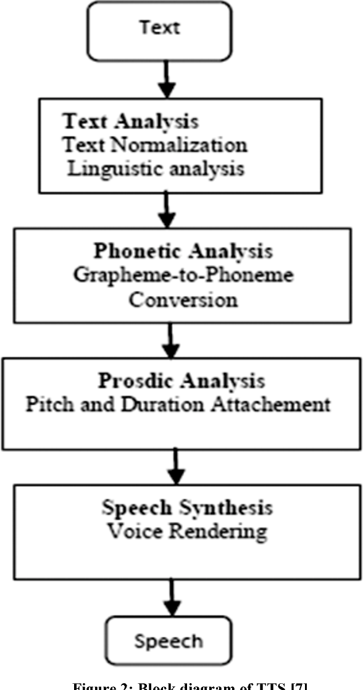
Block Diagram for Text To Speech Conversion

Slide 13
Project working process
Connect the Raspberry Pi to a system using VNC Viewer
Install NOOBS Operating System on the Raspberry Pi 3 Model B using a Micro SD Card
Install Python IDLE version 2 or 3 in the Terminal
Install OpenCV Software, clarifai API and python text to speech on the device using Terminal

Slide 14
Project working process
Connect USB Camera to the Raspberry Pi and install the camera modules in the device
Classify the images
Workers with only Helmet
Workers with only Boots
Using the Clarifai API and then train the model.
Verify that JSON code is generated for above activity.

Slide 15
Coding
Write code for the Camera to start video recording and clicking pictures and saving them in specified directory.
If the camera is not able to read the person’s image, then an audio must be played via speaker asking them to stand in position for face detection.
These images are verified with those trained models in Clarifai API and an accuracy score is generated.

Slide 16
Coding
Based on the accuracy score, the program will decide whether the worker is to be allowed access.
It will convert text to speech and give output via a speaker
A Servo Motor must begin rotating when access is allowed. Else, it will not rotate

Slide 17
conclusion
This paper offers an implementation of a low cost yet powerful computing system for face recognition. The availability of OpenCv proves to be advantageous to design Face recognition system more on local level. The authority provided to the user via mail plays an important role. The use of LBPH algorithm for face recognition works very well provided that the database should have clear images. The more variations of the face training data the system has, the better face recognition are and also the less chances of naming the unknown face from one of the available database. The use of OpenCv library proves to be very effective for face detection and face recognition. The paper shows the integration of OpenCv library with raspberry pi cab be used to build IoT applications.

Slide 18
THANK YOU

